Slide 1
Walmart: Store Expansion Recommendations
Sales by Size, Type of Store,
and Product Placement
at 45 Supercenters Nationwide

Slide 2
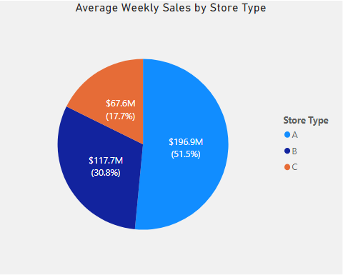
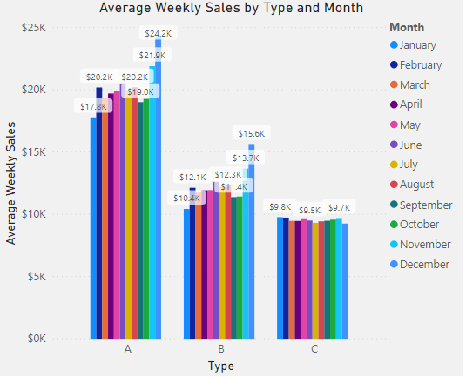
Investing in new Type A supercenter stores with a capacity of 201K and 183K sq. ft. and strategically positioning merchandise inside the stores from departments with the highest sales will maximize sales revenue.
Average Sales by Store Type, YTD, $m, $k
Key Insights
Average sales at Type A supercenter stores were:
50% higher than Type B stores.
98% higher than Type C stores.
Source: Walmart Recruiting - Store Sales Forecasting, accessed 11/24/2019 at https://www.kaggle.com/c/walmart-recruiting-store-sales-forecasting/data

Slide 3
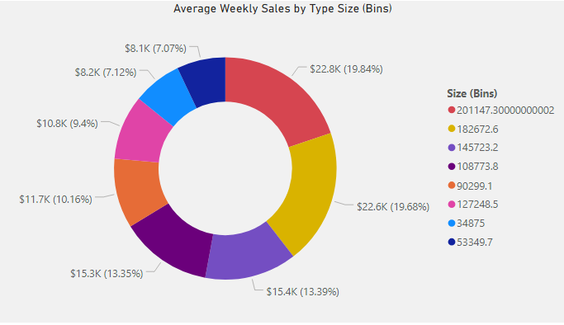
Average weekly sales at supercenter stores with a capacities of 201K sq. ft. ($22.8K) and 183K sq. ft. ($22.6K) together accounted for more than one third of total in-store sales.
Average Weekly Sales by Store Size, $k
Key Insights
Sales at supercenter stores with capacities of 201K and 183K sq. ft. were:
39% higher than stores with capacities of 146K and 109K sq. ft.
66% higher than stores with a capacity of 90K sq. ft.
101% higher than stores with capacities of 53K and 35K sq. ft.
Source: Walmart Recruiting - Store Sales Forecasting, accessed 11/24/2019 at https://www.kaggle.com/c/walmart-recruiting-store-sales-forecasting/data

Slide 4
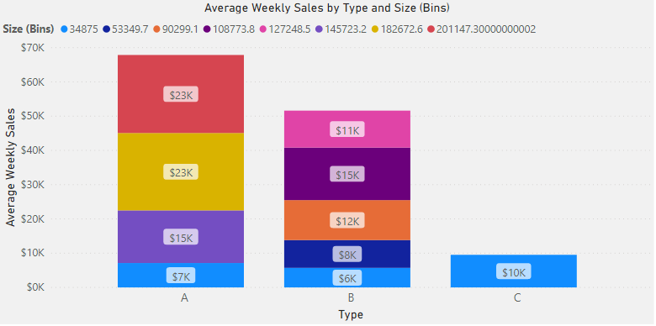
Preference should be given to opening new Type A supercenter stores with a capacity of 201K and 183K sq. ft. These stores had the highest sales average of $23,000/week, representing 39.5% of total in-store sales.
Average Weekly Sales by Store Type and Size, $k
Key Insights
Second highest sales were Type A and Type B stores with a capacity of 146K sq. ft. and 109K sq. ft., respectively, with $15,000 per week.
Third was Type B stores with a capacity of 90K sq. ft. at $12,000 per week.
Source: Walmart Recruiting - Store Sales Forecasting, accessed 11/24/2019 at https://www.kaggle.com/c/walmart-recruiting-store-sales-forecasting/data

Slide 5
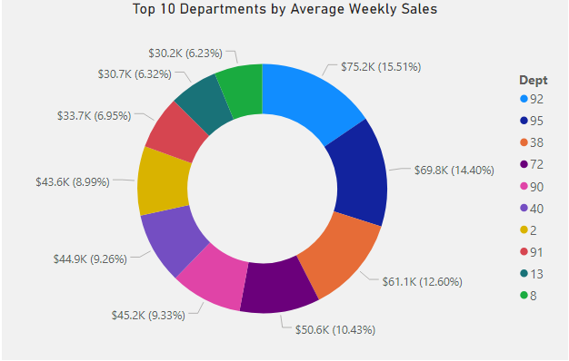
The top 10 departments by average sales account for nearly half (46%) of total in-store sales. To maximize sales at new stores, merchandise from these departments should be positioned in the most heavily-trafficked areas.
Average Weekly Sales by Department, $k
Key Insights
Top 3 departments accounted for 20% of total sales.
Top 5 departments accounted for 29% of total sales.
Top 10 departments accounted for 46% of total sales.
Source: Walmart Recruiting - Store Sales Forecasting, accessed 11/24/2019 at https://www.kaggle.com/c/walmart-recruiting-store-sales-forecasting/data

